Slide 1
Intrusion Detection
System
Team Members:
Sushanth Dondapati
J Viswaksena
T Uday Krishna
B.V.S.S.Sumanth

Slide 2
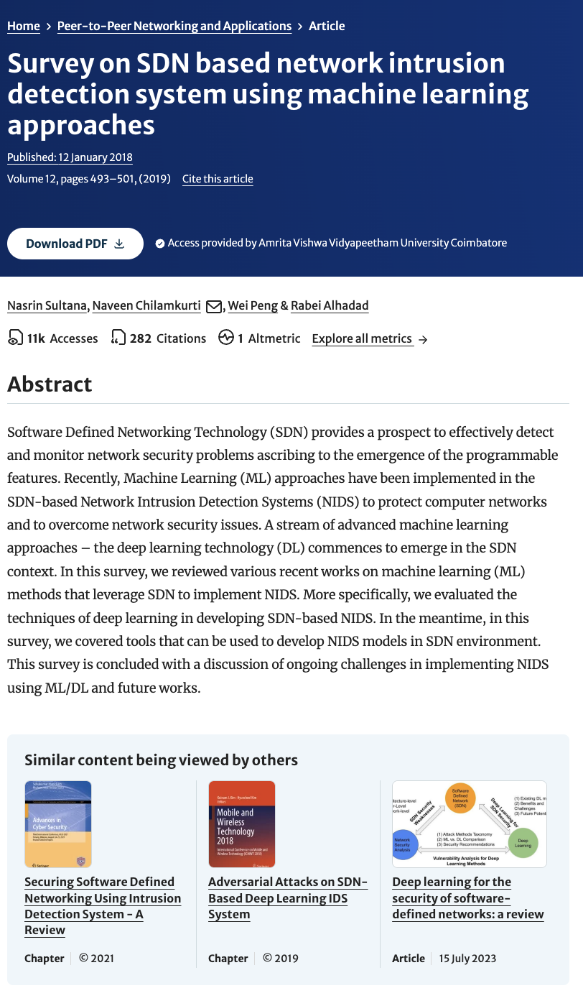
20
21
Survey on SDN based network intrusion detection system using machine learning approaches
Authors : Nasrin Sultana, Naveen Chilamkurti, Wei Peng & Rabei Alhadad
Journal/Conference: Conference
Research Paper
Year of Published : 2018
Citation: Sultana, N., Chilamkurti, N., Peng, W. et al. Survey on SDN based network intrusion detection system using machine learning approaches. Peer-to-Peer Netw. Appl. 12, 493–501 (2019). https://doi.org/10.1007/s12083-017-0630-0
2

Slide 3
Introduction
5
Machine Learning algorithms
C0
DDoS Attack simulation
Dynamic flow control
22
H
Columns of data
SDN Controller integration
Real time monitoring
S

Slide 4
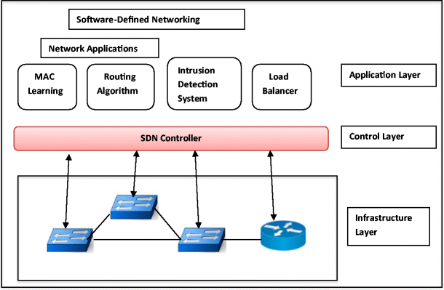
SDN Architecture

Slide 5


Tools for NIDS Model Development
Survey of tools for developing NIDS models in the SDN environment.
Discussion on the significance of these tools in SDN-based NIDS.
ML Methods in SDN
Objectives
Evaluation of various ML methods leveraging SDN for NIDS.
Specific focus on deep learning techniques within SDN.

Slide 6
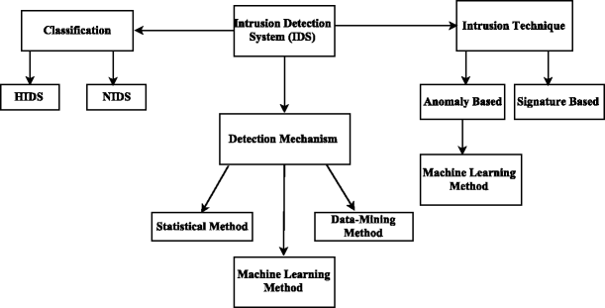
Flow Diagram

Slide 7


Data
Schema
Traffic
Generation
Dataset
Creation
Feature
Extraction
Model
Training
Predicting
Model
Performance Evaluation
Real-time
Evaluation
Methodology

Slide 8



hping3
Simulation
Tools
Iperf
Mininet

Slide 9


20
21
RYU controller
Development Tools
SDN Framework
The framework provides network programmability and management through a flexible architecture, modularity, and robust tools.
OpenFlow
Communication Protocol
9

Slide 10

Work done by the team
Mininet is Up and Running successfully creating topology.
Integrated RYU Controller for SDN network devolopment
Successfully used an ML algorithm to predict DDOS attacks.

Slide 11
Results
Subtitle text here
66%
96%
Logistic Regression
Decision Tree

